Slide 1
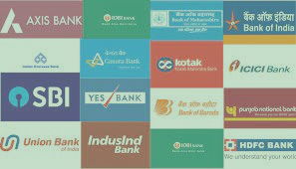
Performance Analysis
HDFC Against Industry

Slide 2


About HDFC Bank
HDFC Bank Limited (also known as HDB) is an Indian banking and financial services company headquartered in Mumbai. It is India's largest private sector bank by assets and world's fourth largest bank by market capitalization as of July 2023, following its takeover of parent company HDFC. It is the second largest company by market capitalization of $172 billion on the Indian stock exchanges. It is also the sixteenth largest employer in India with nearly 1.78 lakh employees.

Slide 3






History and evolution
of HDFC
2016
2018
2020
2021
Best Banking Performer, India in 2016 by Global Brands Magazine Award.
BrandZ Rankings, Most Valued brand in India for third successive year
Company of the year: The Economic Times Corporate Excellence Awards.
NPCI - National Payments Excellence Awards
Best Bank in India: Euromoney Awards
Best Bank in India: FinanceAsia Country Awards
Best bank in india: FinanceAsia Country Awards
Best bank for SMEs: Asiamoney best bank awards

Slide 4

Problem
The management at HDFC Bank have no means of comparing their performance in the debit and credit cards segment with industry. This is posing difficulty in strategic-planning and decision-making.
Help them by creating a dashboard to show how well HDFC performed as compared to other top banks in the Indian banking sector.

Slide 5

Objective
To remain competitive and make informed decisions, the bank's leadership recognized the need for a comprehensive card usage dashboard. This dashboard will monitor the following key performance indicators (KPIs):
No. of cards issued
Transactions
Spending
Spend per card
Average transaction size

Slide 6

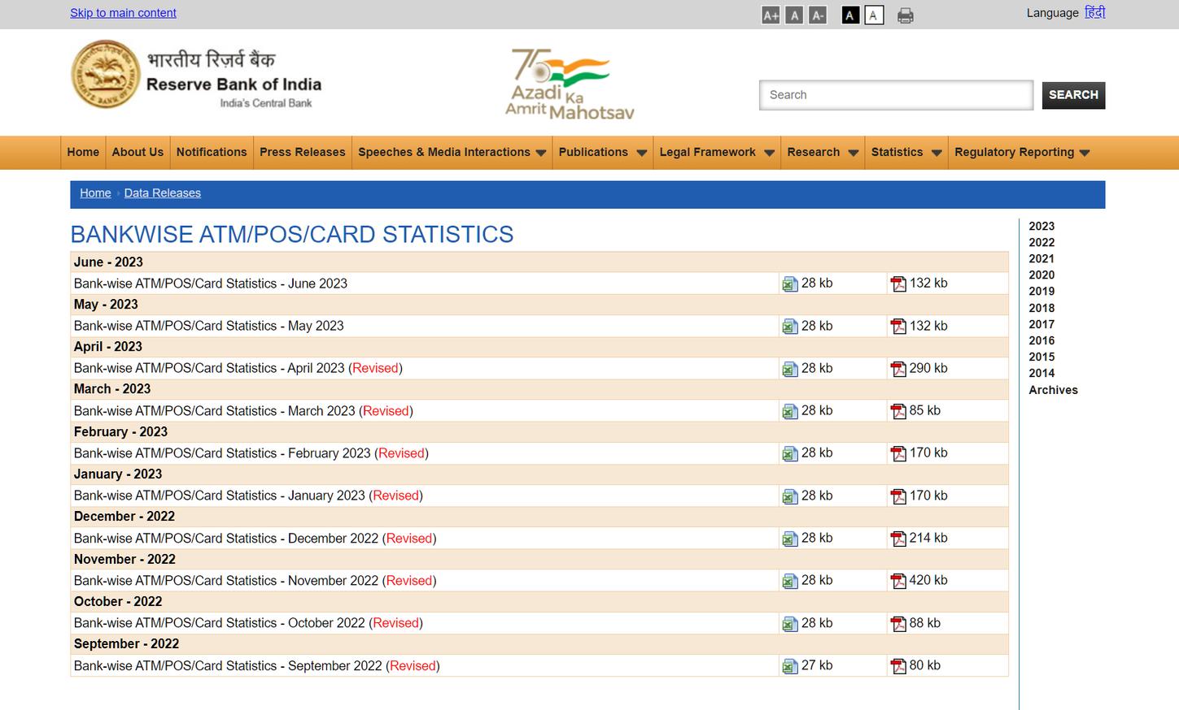
Data Scraping from Web
Scraping the data from Apr-22 to Mar-23 using the link given below.
Link to RBI website: https://www.rbi.org.in/Scripts/ATMView.aspx

Slide 7




Data Cleaning and Transformation Tools
SQL server management
studio
Microsoft Excel
Microsoft PowerBi

Slide 8
Data Cleaning
Here are the rules we followed to prepare the data for building the dashboard:
Deleted columns that are not related to credit or debit cards.
Unmerged merged cells.
Aggregated "Volume" and "Value" for all the transaction modes (PoS, Online, Others.) "Value" should be in ₹ and NOT in ₹ '000s. Do not consider "Cash Withdrawal."
Remove "Payment" and "Small Finance" banks. Tag the remaining banks as "Public, Private, and Foreign."
Delete any empty rows or columns

Slide 9
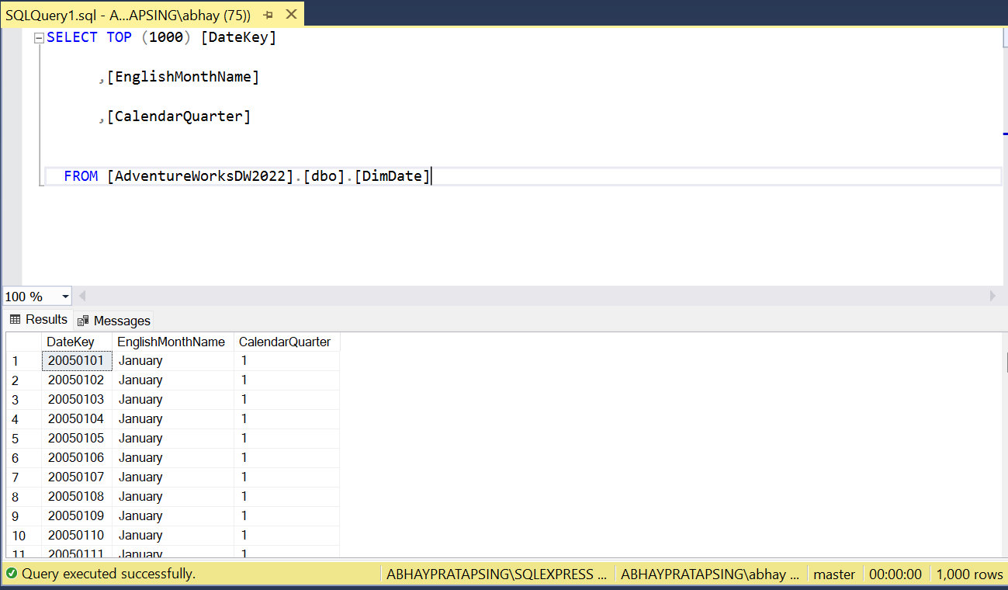
Date Dataset SQL Query

Slide 10


Data Understanding
Bank Name: Name of the bank
No of Cards: Total no of Cards (Debit and Credit )
atpos_Volume (in actuals):No of transaction at pos
atpos_Value (in Rs'000):Spending at pos
online_Volume (in actuals):No of online transaction
online_Value (in Rs'000):Online spending
others_Volume (in actuals):Other Transactions
others_Value (in Rs'000):Other Spendings
transactions:Total tranaction
inr_value:Total Spending
Month:Month of year
Card_type:Type of card credit or debit card
Bank Type:Public, Private, or Foreign
pos:A point of sale (POS) is a place where a customer executes the payment for goods or services and where sales taxes may become payable.

Slide 11

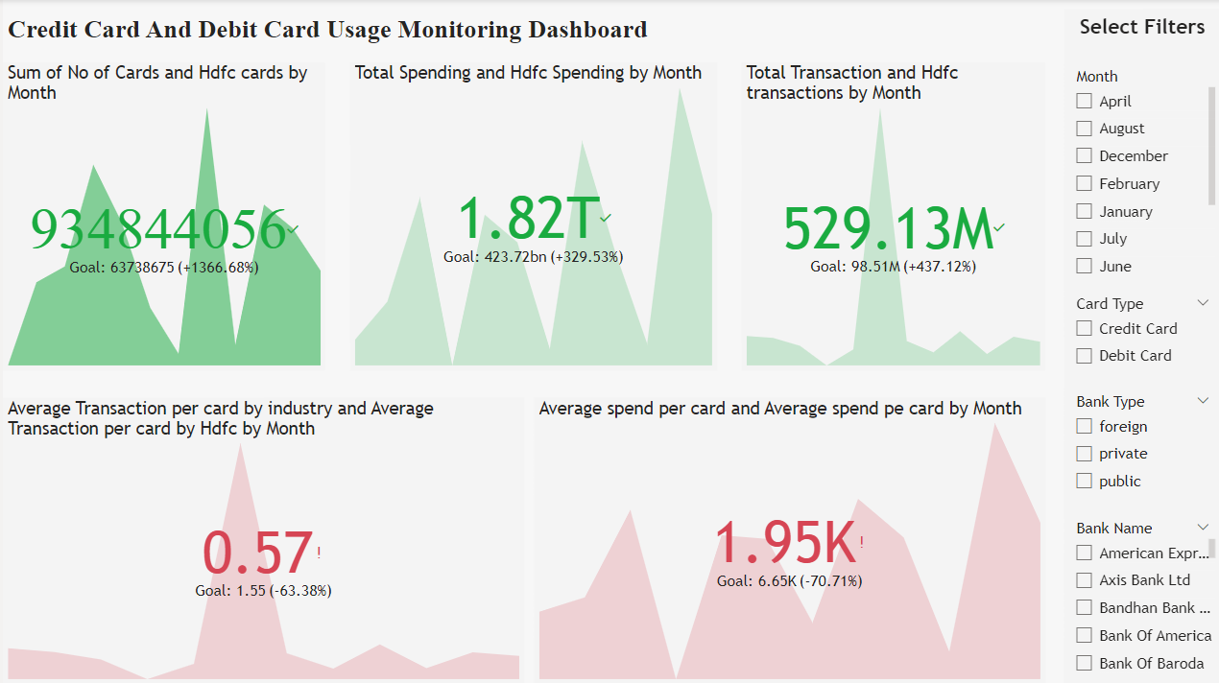
Debit And Credit Card Usage Monitoring Dashboard
These are required filter such as Month ,Card Type, Bank Type and Bank Name for

Slide 12
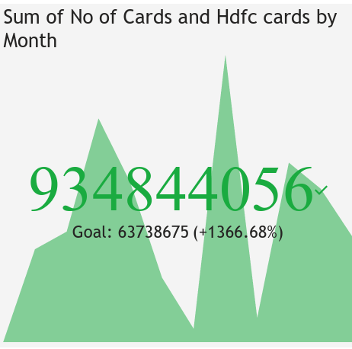

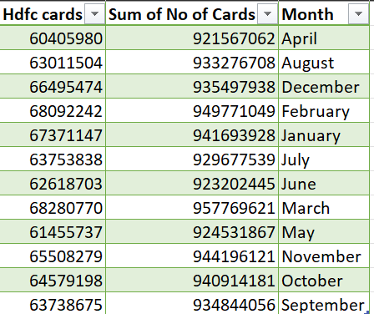
Total Number Of Cards By Industry And HDFC Bank
Industry
This KPI is showing the number of card (Debit or credit )by industry and HDFC bank per month.
We can use aur filters to filter the required data for decision making
HDFC Bank’s

Slide 13
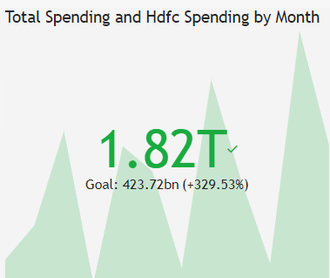
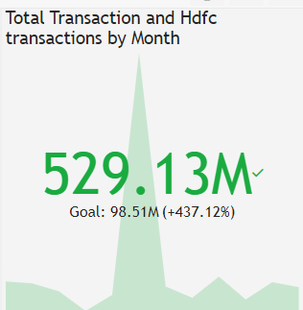
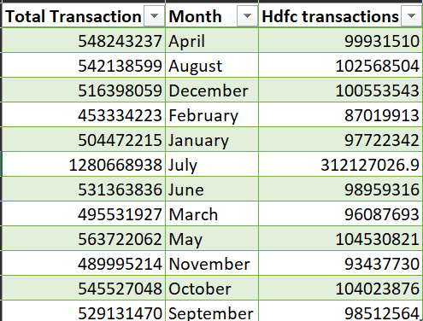
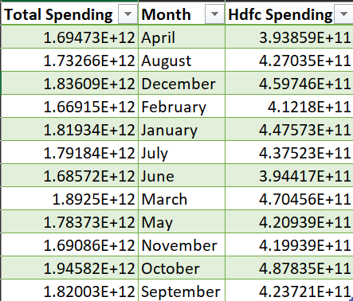
Transaction by industry and HDFC per month
Spending by industry and HDFC per month

Slide 14
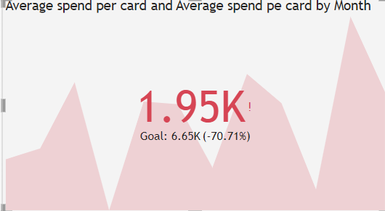
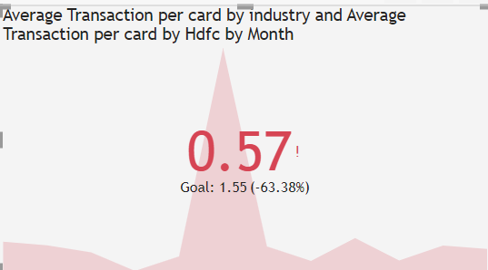
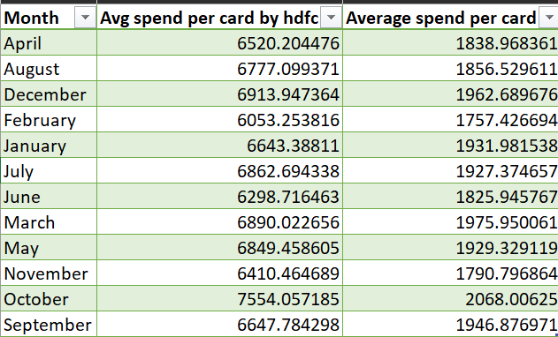
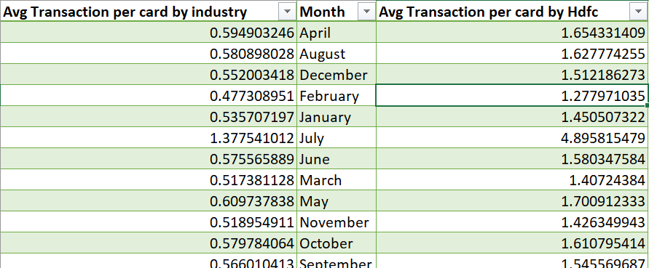
Average Spending Per Card
Average Transaction Per Card

Slide 15
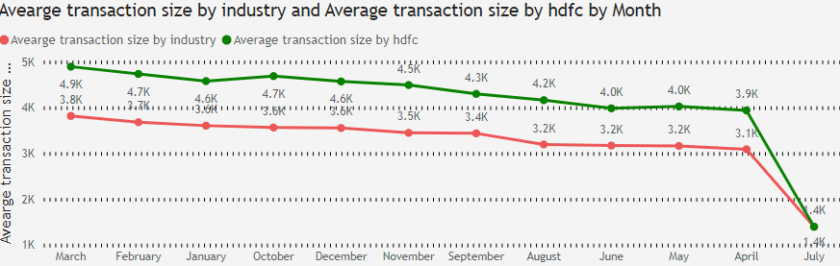
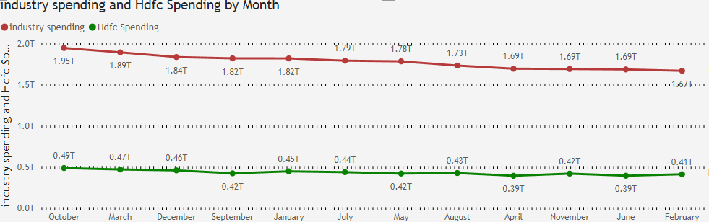
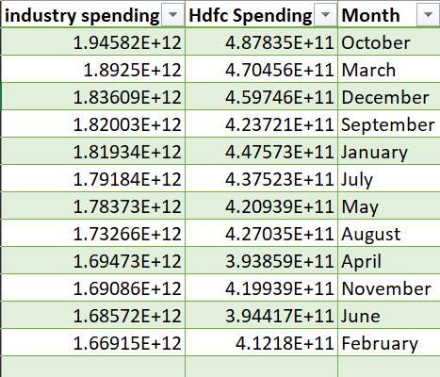
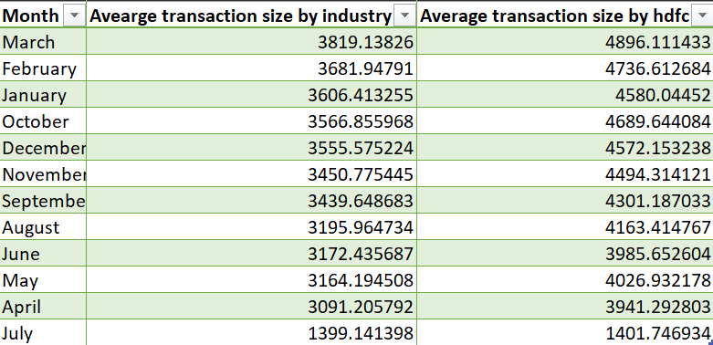
Average Transaction Size by industry and HDFC per month
Average Spending by industry and HDFC per month

Slide 16
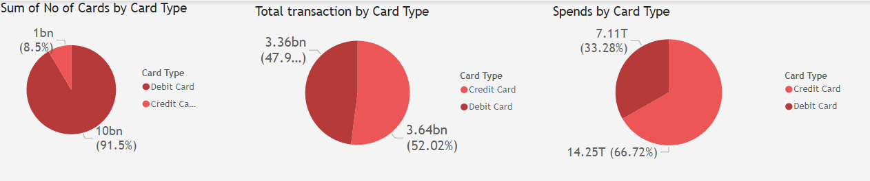
Analysis on the basis of Card Type
As we can see the number of debit cards issued by banks are more than credit cards showing that debit cards hold large audience but credit cards are used more than the debit cards as the number of transactions and total spending are greater than that of debit cards.

Slide 17
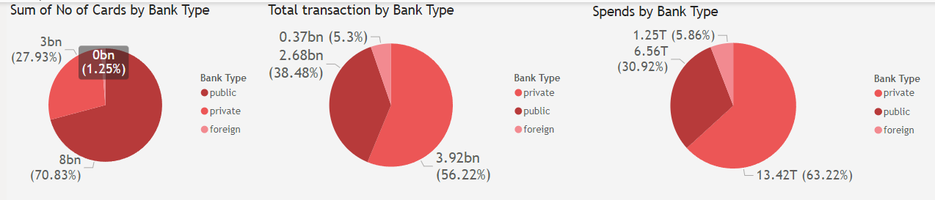
Analysis on the basis of Bank Type
From above visuals we can clearly say that Public Banks have more number of cards but cards of Private Banks are more in use as the amount spend and the number of transactions are significantly more than Public/Foreign Banks

Slide 18
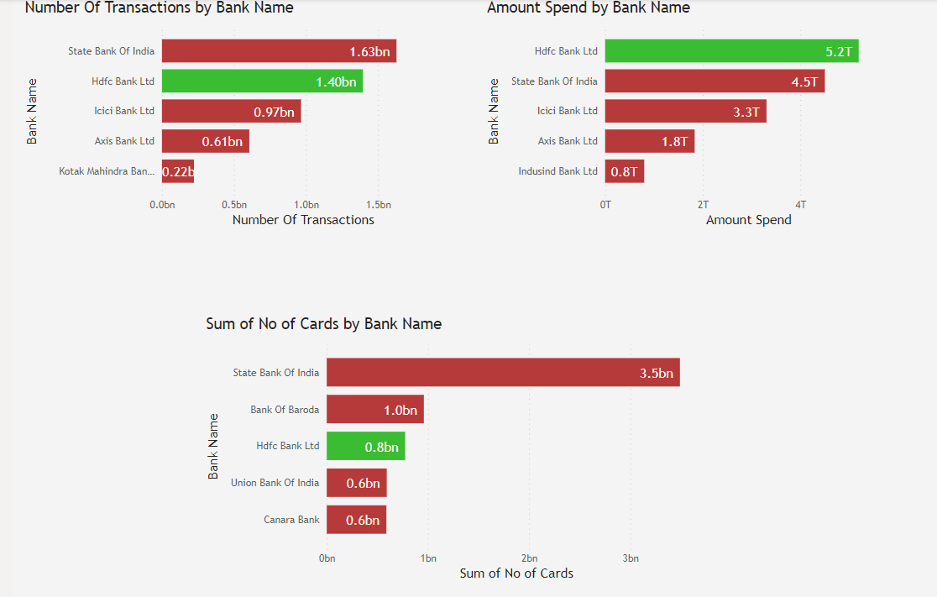


Top 5 Banks in Industry
HDFC Bank is most spending bank.
HDFC Bank is second most used bank.
As HDFC Bank is on third position for number of cards but is on top of ranking in amount spend and number of transactions shows the popularity and usage of HDFC Bank Cards.

Slide 19
Top Insights
Average transaction and Average spending per card for HDFC bank is more than the whole industry .
So HDFC Banks Cards are used frequently by the users.
Their are more users of Debit Card than that of Credit Card, but Credit Cards are used more frequently and amount spent using them is more than Debit Cards.
Public Banks have issued large number of cards but the cards used by users more are of Private Bank.
Foreign Banks are not popular as private banks.
After analyzing all data we can say that State Bank Of India and HDFC Bank are top Bank of Public Bank and Private Bank category respectively .

Slide 20
Customer’s Rating
Public Bank
Private Bank
Banking Services and products are common in both public an private sector bank But Public sector bank are way ahead in providing services to the marginalized section of society.
The Private Sector also provides similar services as in public sector banks but the only difference is that they focus on higher customer satisfaction and services.

Slide 21













Thank you very much!

